Slide 1
Make Your Move Easy with Microsoft’s Enhanced Migration Tool
Kasey Metzger
Product Leader
Enavate

Slide 2
Support Our Dynamics Teams in the Ukraine!

Slide 3
What is the GP Cloud Migration Tool
What enhancements is Microsoft making
Moving your GP data to Azure Data Lake
Look at your migrated GP data in BC
Q&A

Slide 4
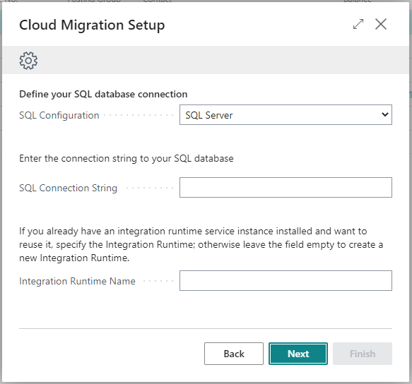
Migration Tool Setup Wizard
Delegated Admins can now run the migration wizard
Enables connection between on-premises data and cloud tenant
No data is stored in this pipeline
Migrate on-premises data to the cloud – Business Central Microsoft Docs

Slide 5
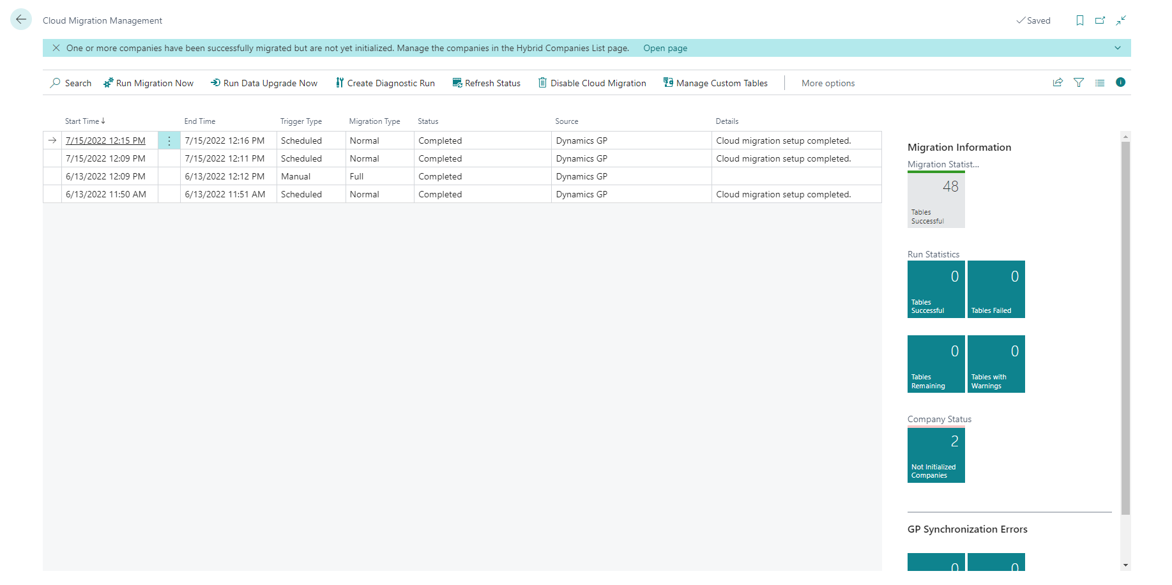
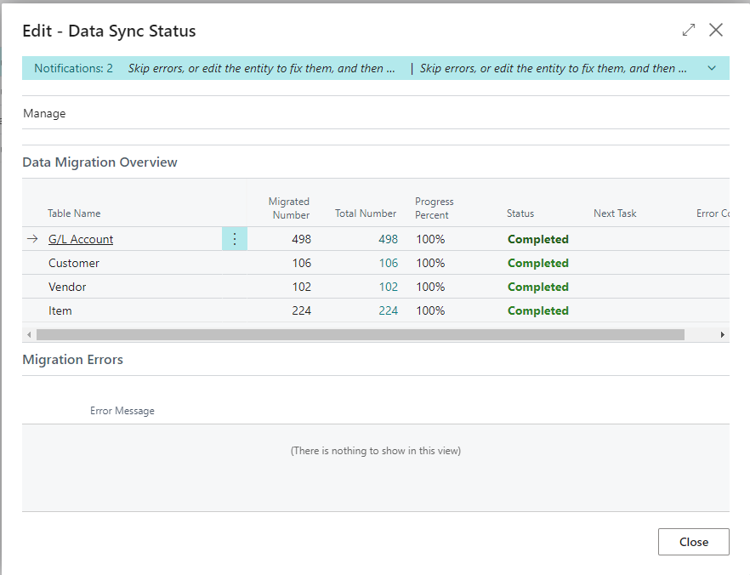
Migration Management
Perform Diagnostic Run
Run Migration now
Moves GP data to staging tables
Run Data Upgrade Now
Moves data from staging to permanent BC tables
Verify results
Disable Cloud Migration

Slide 6
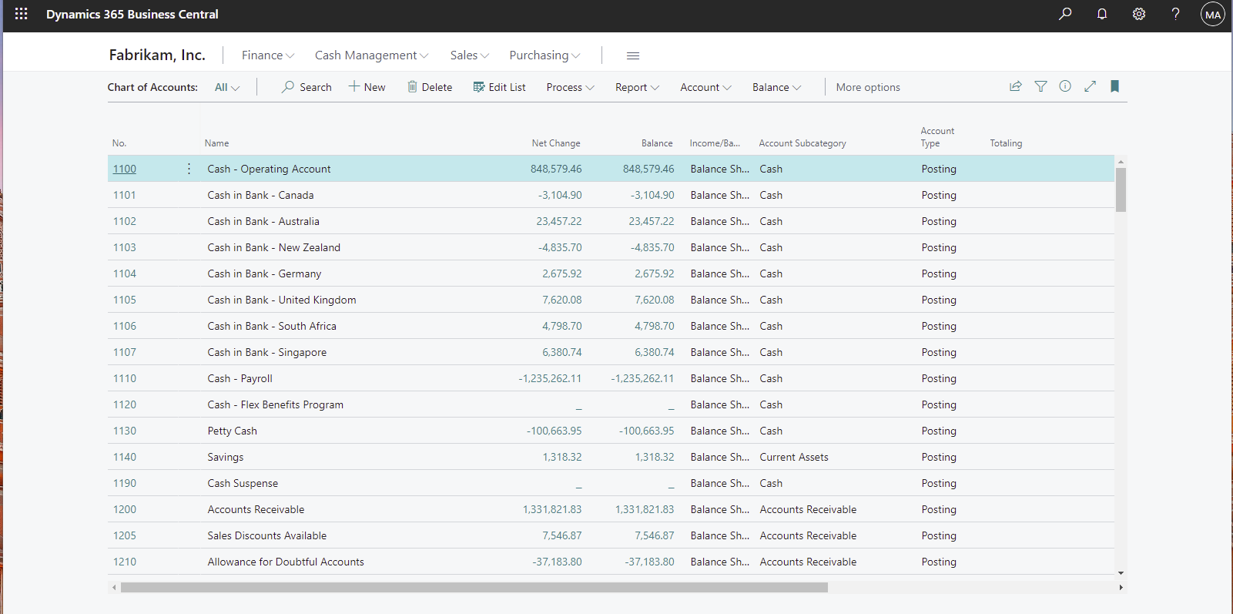
Migrated Data
GL Accounts
Segments as Dimensions
Fiscal Periods
GL summary transactions history and open years
Bank Accounts
Unreconciled Bank Transactions

Slide 7
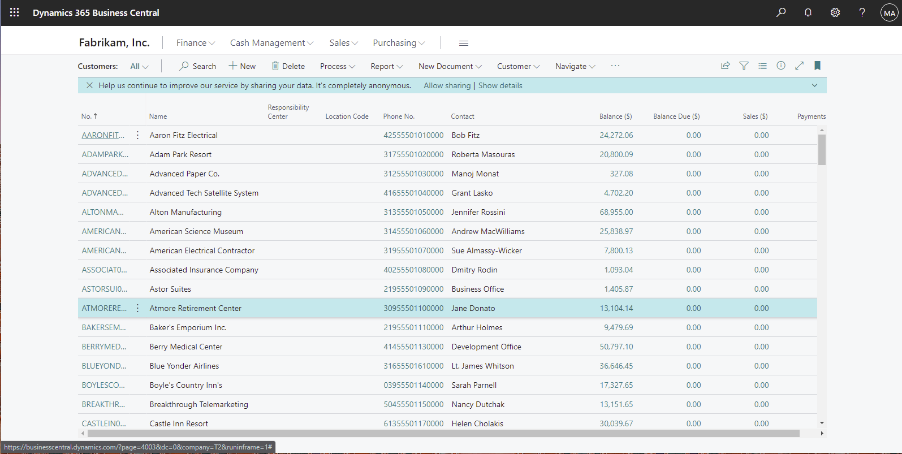
Migrated Data
Customers
Open Receivables Transactions
Vendors
Open Payables Transactions
Open Purchase Orders
Items
Locations
Inventory Quantity on Hand
Serial/Lot Information

Slide 8
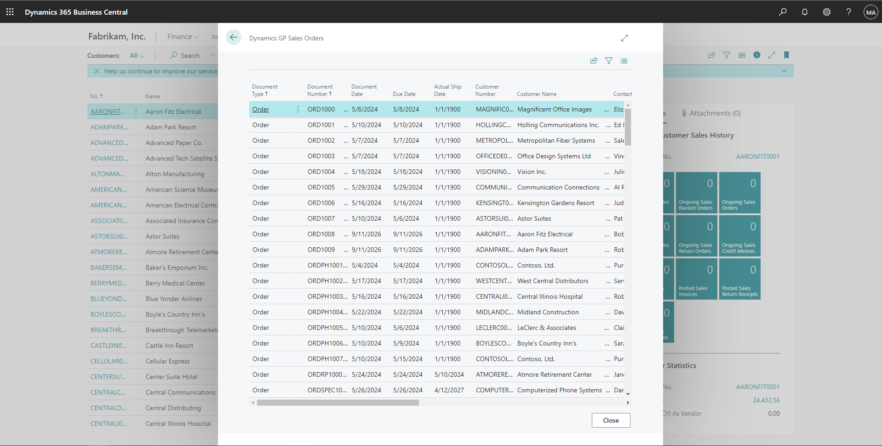
Migrated Data
Supporting data:
Salespeople ID
Payment terms
Shipping method ID
Add’l customer and vendor ship to and order addresses
Vendor EFT information
Sales, Purchasing, Inventory, Payables and Receivables history data is brought over into Business Central Extension tables

Slide 9
New and Upcoming Features in Migration Tool
Enhancements to GP Cloud Migration Tool
NEW FEATURES
LATEST FEATURES (20.5)
UPCOMING
Exclude inactive checkbooks (20.1)
Vendor remit as Main address (20.1)
Unreconciled bank transactions (20.3)
Add’l columns in GP trx lists (20.3)
Fiscal Periods (20.3)
Vendor EFT information (20.3)
Vendor class accts to posting groups
Customer class accts to posting groups
Item class accts to posting groups
Limit # of historical GL years
New GP Configuration settings
Module selection in migration
Enable Master data only in migration
Exclude Inactive and Discontinued items

Slide 10
Azure Data Lake
Easily access your GP data after migration by creating a copy of your GP database
Create a storage account in Azure
Copy your GP data
View and build reports on your historical data

Slide 11
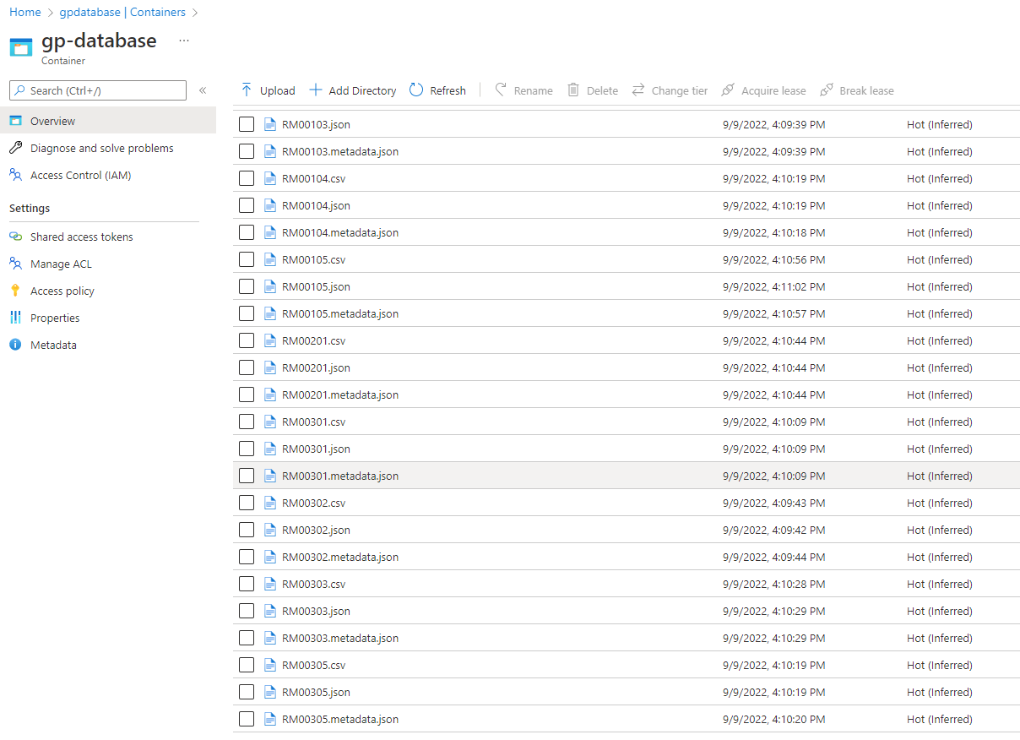
Data Lake – Same Data and Folder

Slide 12
Next Steps
Connect with your Partner and discuss migration options
Take advantage of current Microsoft migration offers
Read Microsoft Release Plan
Sign up for Cloud Migration Assessment

Slide 13
Q & A

Slide 14
If you have any other questions, please see me after this session!
Kasey Metzger
Product Leader
Enavate

Slide 16
Your feedback matters!
Please scan the QR code below and let us know your thoughts on today's session:
Notes:
What system they are on
What brought

