Slide 1
Dynamics GP Integration Options – What to Do as Scribe Insight Reaches End of Life Cycle
Roger A. Vander Lugt
Senior Consultant
Enavate

Slide 2
Support Our Dynamics Teams in the Ukraine!

Slide 3
Review Scribe’s End of Life Cycle Announcement
Migration Planning and Strategy
High Level Review of Options
Integration Options/Demos
Questions and Answers

Slide 4
End of Life Cycle Announcement
Originally announced in June of 2021
Revised in January of 2022
TIBCO announced the retirement of the following product, and cease providing maintenance for the product, as of 11:59pm Pacific Time on November 30, 2022
This applies to Scribe Insight and all adapters, including:
- TIBCO Scribe Insight Adapter for Microsoft Dynamics AX
- TIBCO Scribe Insight Adapter for Microsoft Dynamics 365 and CRM
- TIBCO Scribe Insight Adapter for Microsoft Dynamics GP
- TIBCO Scribe Insight Adapter for Microsoft Dynamics NAV
- TIBCO Scribe Insight Adapter for Salesforce
- TIBCO Scribe Insight Adapter for Saleslogix
- TIBCO Scribe Insight Adapter for Web Services
During the retirement phase, TIBCO Support will continue to service this product as explained in customer maintenance agreements. However, enhancements will no longer be made to the products.

Slide 5
STRATEGY

Slide 6
Migration Strategy
Review and document current integrations
Use the Scribe Console to review automated integrations
Use the DTS report included in Scribe Insight Note: The report does not include some items, you will want to document those separately
Create/update test environments
Build and test with new solution
Move to production

Slide 7
Understanding the Scribe Console
Collaborations – This section shows each of the Collaboration folders you have and the Integration Processes within each one
Integration Server – This section shows all of the Integration Processes, any Publishers and Bridges you are using, and the Queues used with Message Queueing
Administration – This section has access to the Execution Log, the Alert Log, Site Settings, Alert Recipients and Security

Slide 10
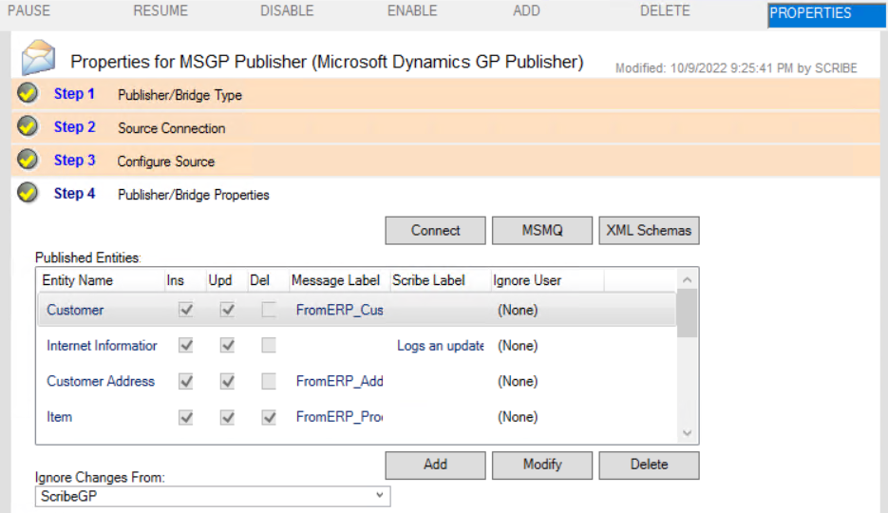

Slide 11
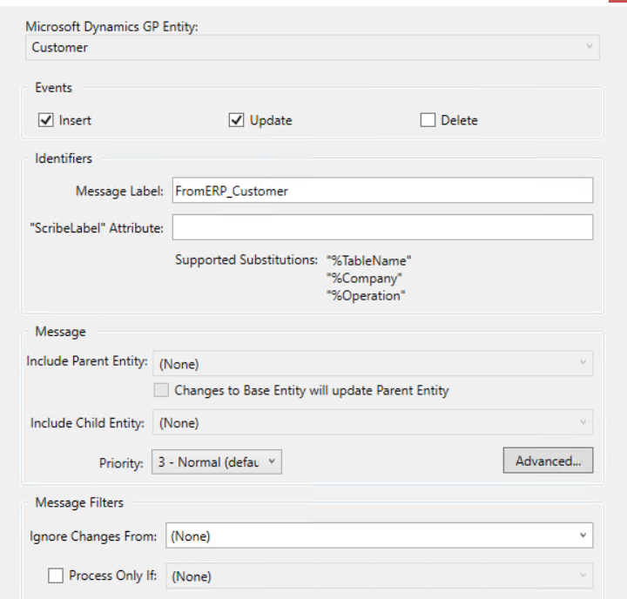

Slide 12
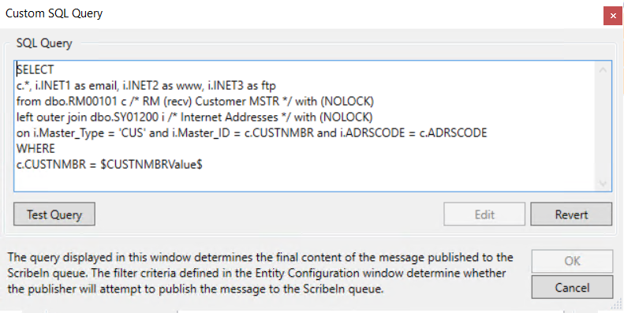

Slide 13
Understanding the Scribe DTS Report
DTS – This section gives the path/name of the DTS and includes any Description and/or Comments that have been included in the DTS

Slide 14
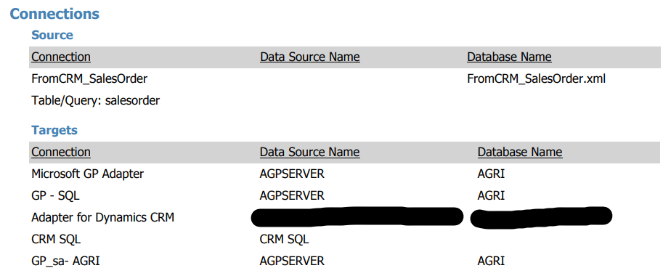
Understanding the Scribe DTS Report
Connections – This section identifies the sources and target connections for this DTS

Slide 15
Understanding the Scribe DTS Report
Target Steps – This section lists each of the steps this DTS goes through and the logic to follow for Failure and Successes
If Step Control logic exists, the report will fail to include that – review and document separately

Slide 16
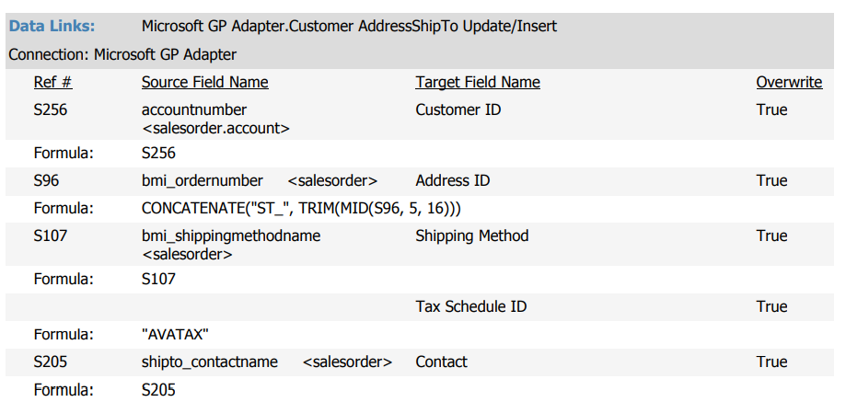
Understanding the Scribe DTS Report
Data Links – This section shows how each of the Target fields are supplied with data

Slide 17
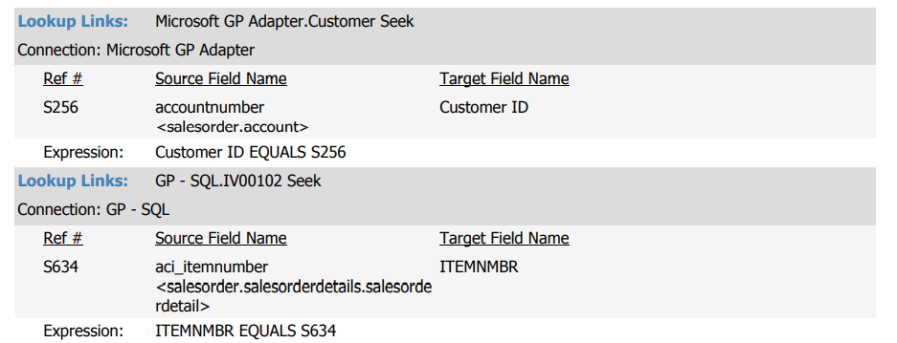
Understanding the Scribe DTS Report
Lookup Links – These define how data from the Source and Target were linked for Seek and/or Update related steps

Slide 18
Integration Options
TIBCO Cloud Integration
eOne Solutions SmartConnect
Dynamics GP Integration Manager
Microsoft eConnect
A couple honorable mentions:
Cavallo Bridge (formerly Automation Agent)
Boomi

Slide 19
TIBCO Cloud Integration
Pros: - Robust, web-based solution - A vast array of connections Connectors | TIBCO Software - Intuitive dashboard and scheduling
Cons: - Can seem too technical - Pricier than other solutions

Slide 20
TIBCO Cloud Integration

Slide 21
SmartConnect
Pros: - On-premise or web-based solution - Large number of connectors - Easy to use interface - Excel Add-in for direct integrations
Cons: - Pricing model based on connections - Coding options – JavaScript for SmartConnect.com and either VB or C# for on-premise is confusing

Slide 22
SmartConnect
Demo​

Slide 23
Integration Manager
Pros: - Easy to use - Mimics the data entry into GP
Cons: - Price is almost as much as the automated options - No automation – users must log into GP to run - Only integrates data into GP – no 2 way integrations

Slide 24
Integration Manager Demo
DEMO

Slide 25
Microsoft eConnect
Pros: - No additional purchase – included with Microsoft Dynamics GP - Contains the GP business logic needed to successfully integrate
Cons: - Very technical to deploy - Fairly difficult to run and maintain - Only for use with integrating into Dynamics GP

Slide 26
Honorable Mentions
Cavallo Bridge: - Only works if you use SalesPad Desktop - Provides automation for batch workflows and can be used for integrations from various web platforms
Boomi: - Very nice user interface - Completely cloud based - Not nearly as well known as the other solutions

Slide 27
Next Steps
ACT NOW – Support ending 11/30
Contact your partner for demos/recommendations
Visit Booth #1214 to ask any additional question and enter to win our Grand Prize Giveaway Enter to win our Grand Prize Giveaway (Your choice of 5 fantastic items)!

Slide 28
Q & A

Slide 29
If you have any other questions, please see me after this session or at the Enavate Booth (#1214)!
Roger A. Vander Lugt
Senior Consultant
Enavate

Slide 30
Check Out Our Next Sessions!
Wednesday | October 12 | 3 p.m. Tampa 1 - Convention Center, Level 2 - Change is Hard. But Moving from On-Premises to the Cloud Doesn’t Have to be with Business Central.
Wednesday | October 12 | 3 p.m. Osceola A - Convention Center, Level 2 - Surviving the War: When Online Apps Become Real Life Solutions
Thursday | October 13 | 9 a.m. Osceola A - Convention Center, Level 2 - Sneak Peek: See What GP Processes Look Like in BC
Thursday | October 13 | 11:15 a.m. Naples 3 -Convention Center , Level 2 - GP to BC: Make Your Move Easy with Microsoft’s Enhanced Migration Tool

Slide 31
Scan here to complete the survey. Your opinion matters!

