Slide 1
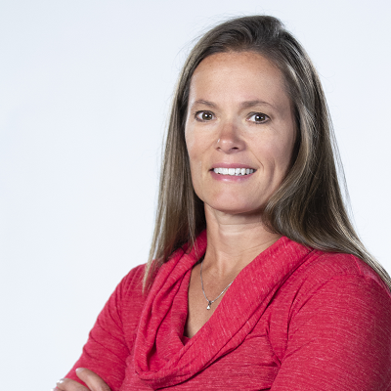
Sneak Peek: See What Dynamics GP Processes Look Like in Business Central
Jennifer Ranz
Product POD Leader
Enavate

Slide 2
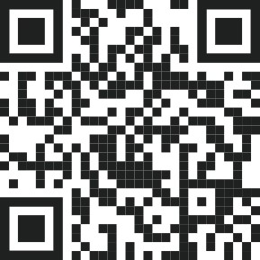

Support Our Dynamics Teams in the Ukraine!

Slide 3
What does your data from a GP migration look like in Business Central?
Functionality in Business Central
Great tools/documentation for Business Central
Next Steps
Q&A

Slide 4
Demo of Features Dynamics 365 BC

Slide 5
Next Steps
Dynamics 365 Partner Portal (microsoft.com)
Check out videos – Microsoft You Tube Channel
Demo environment of Business Central Microsoft Customer Digital Experiences
Contact Enavate for more information! (info@enavate.com)

Slide 6
Check Out Our Final Session!
    Thursday | October 13 | 11:15 a.m. Tampa 2 -Convention Center , Level 2
    - GP to BC: Make Your Move Easy with Microsoft’s Enhanced Migration Tool

Slide 7
Q & A

Slide 8

If you have any other questions, please see me after this session!
Jennifer Ranz
Product POD Leader
Enavate

Slide 10
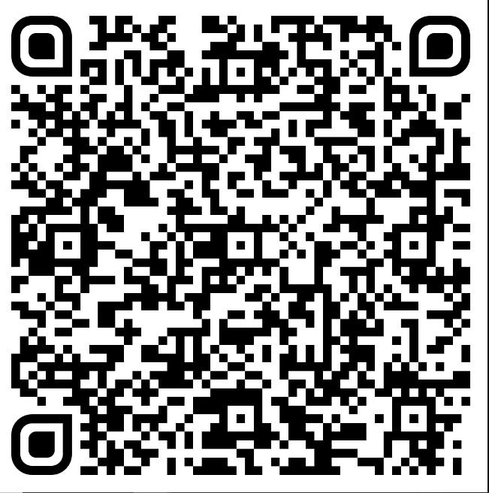
Your feedback matters!
Please scan the QR code below and let us know your thoughts on today's session:
Notes:
What system they are on
What brought

