Slide 1


Support Our Dynamics Teams in the Ukraine!

Slide 2

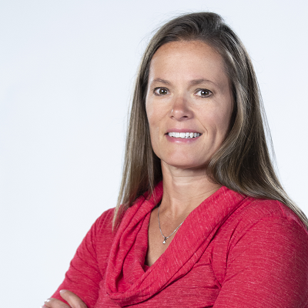
SURVIVING THE WAR:
When Power Platform Online Apps Become Real Life Solutions
Kevin Armstrong
Global Enterprise Strategy Leader
ENAVATE
Jennifer Ranz
Product POD Leader
ENAVATE

Slide 3
Our story
The evolution of Power Platform
What options did we have?
Why this was crucial?
Designing the app
Steps towards success
Q & A

Slide 4
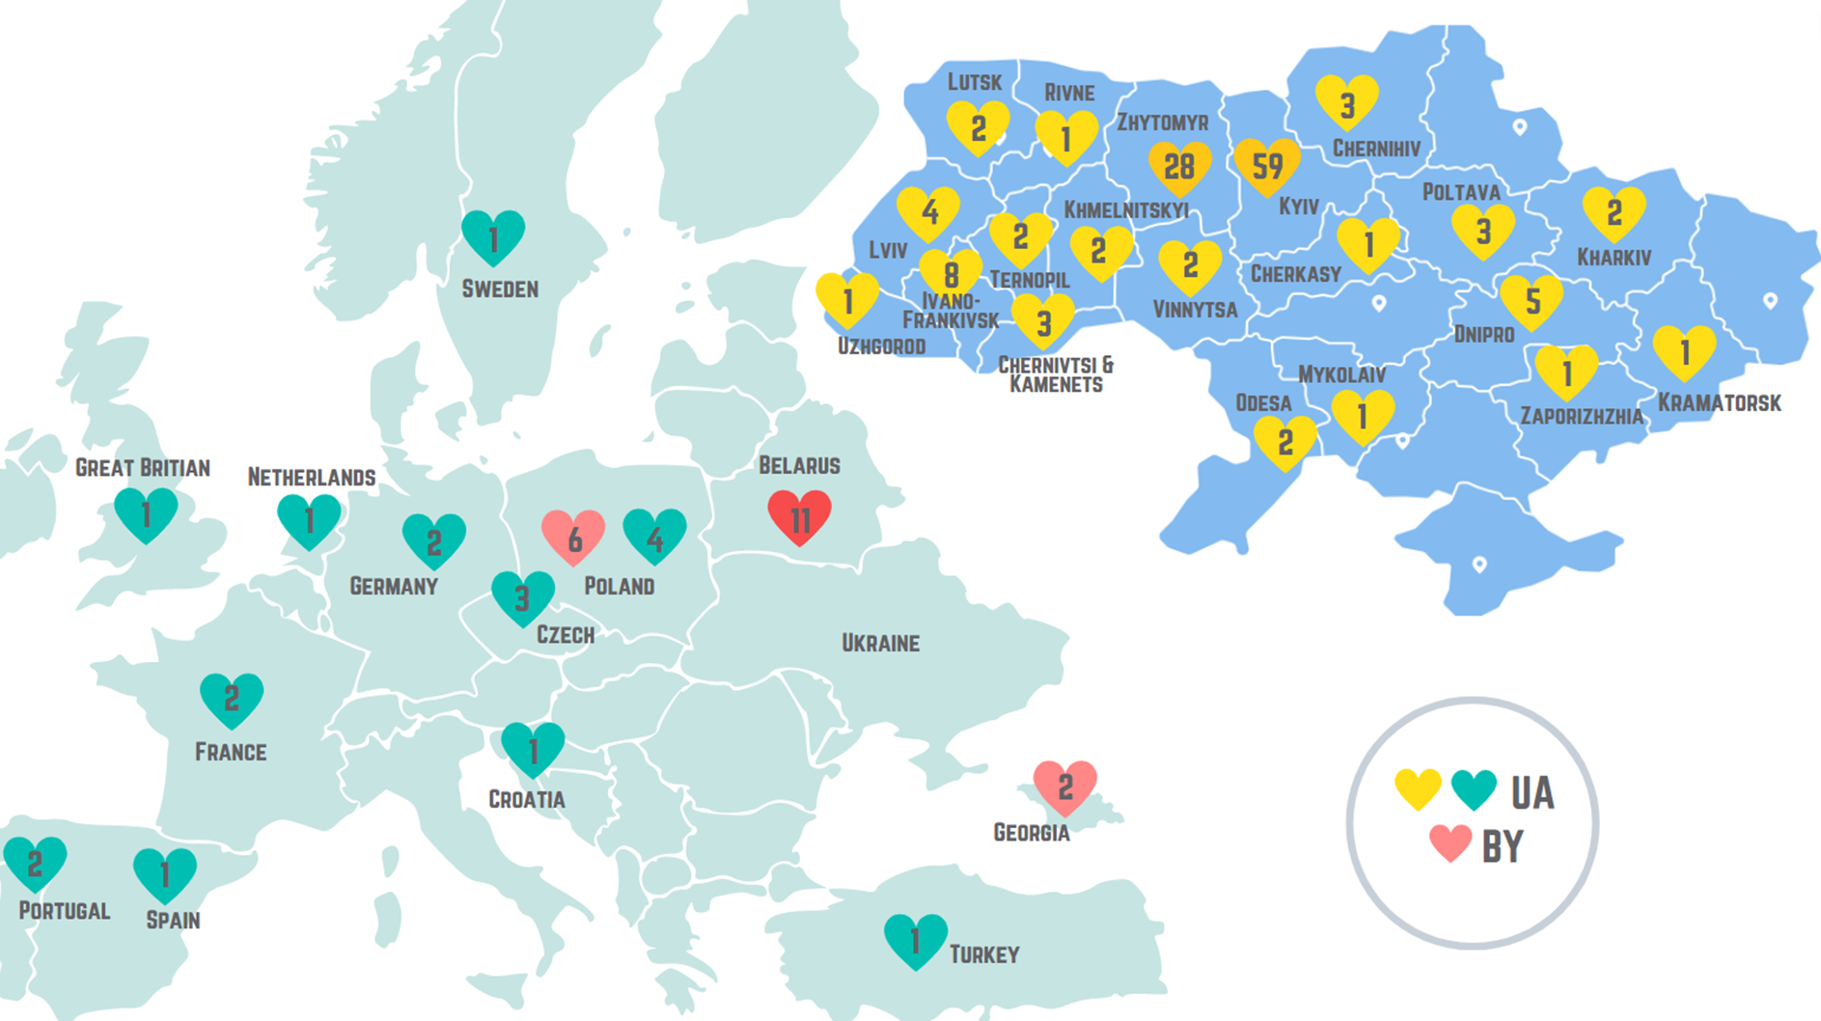
And Overnight Everything Changed
In February 2002 Enavate had offices in the Ukraine and Bela Rus when the war started.
We about 200 team members and their families that were immediately impacted
Teams of people were working from bomb shelters every day or moving quickly to other regions/country
We needed a way to track them and their safety immediately!

Slide 5
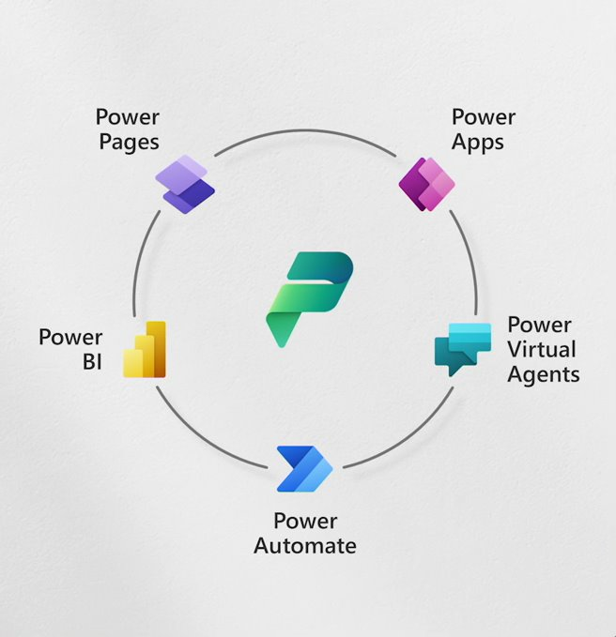
Evolution to Power Platform
Working Through Email
Tracking in Excel Spreadsheets
Phone Calls

Slide 6
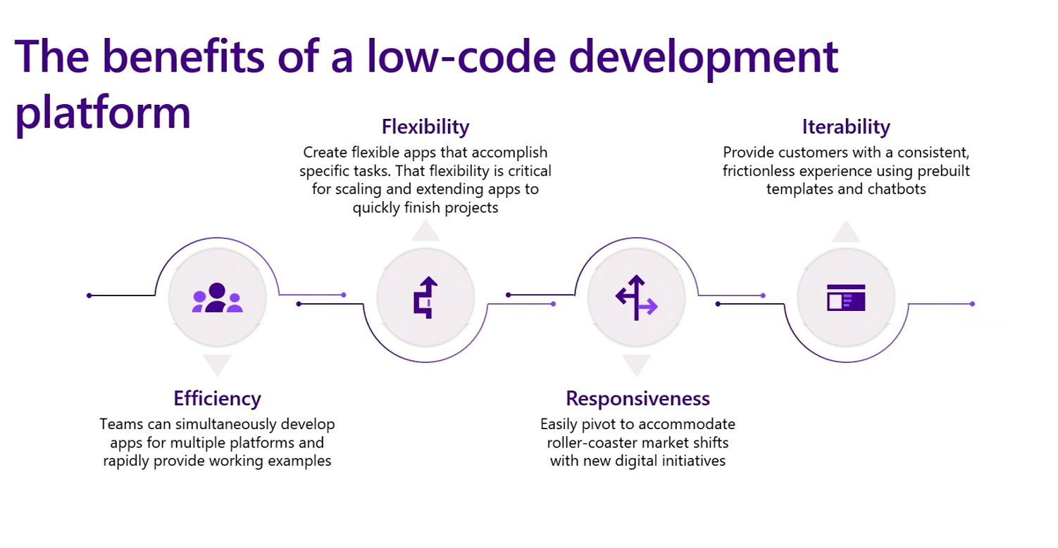
Power Platform Benefits

Slide 7
Designing our App
Minimum Requirements
Timeline
Development/Testing
Rollout
Flexibility on iterations

Slide 8
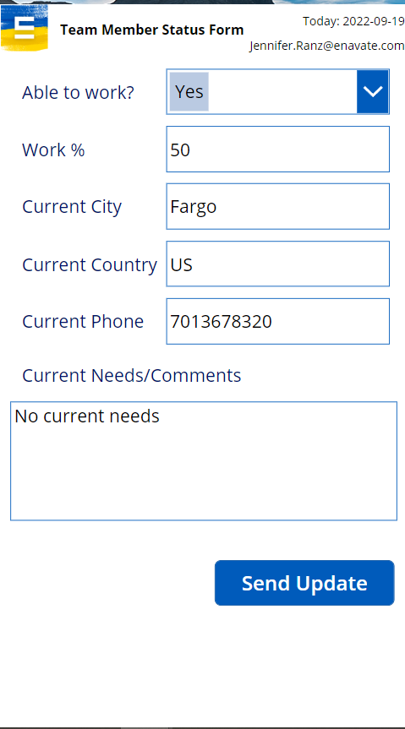
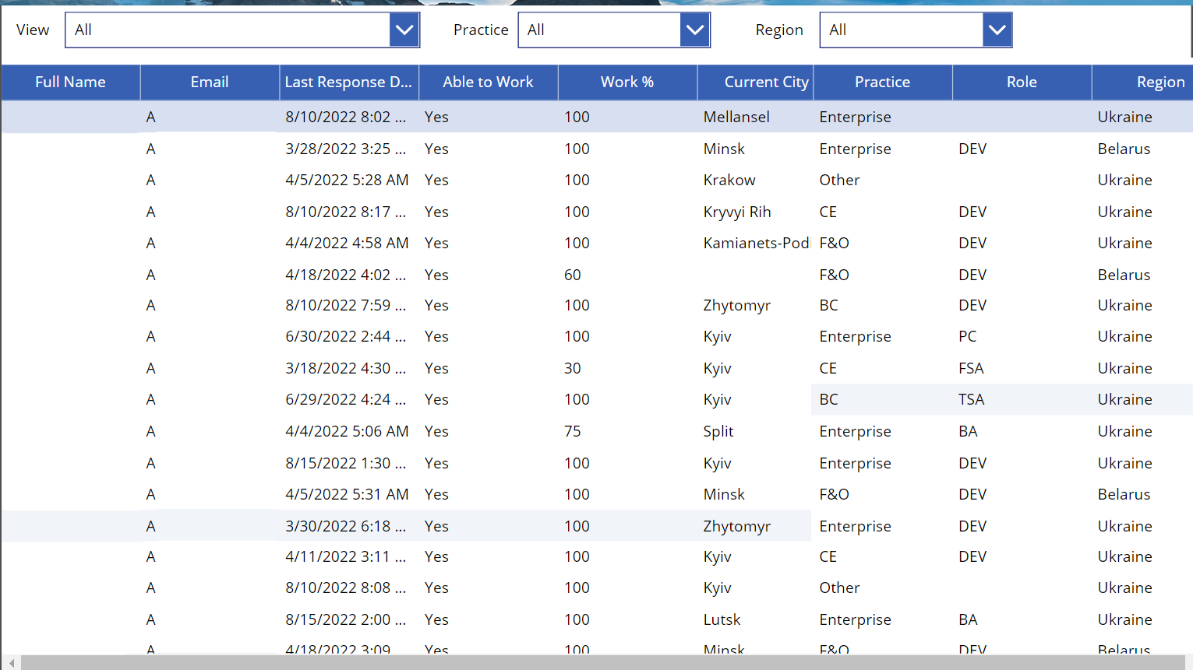
View of App

Slide 9
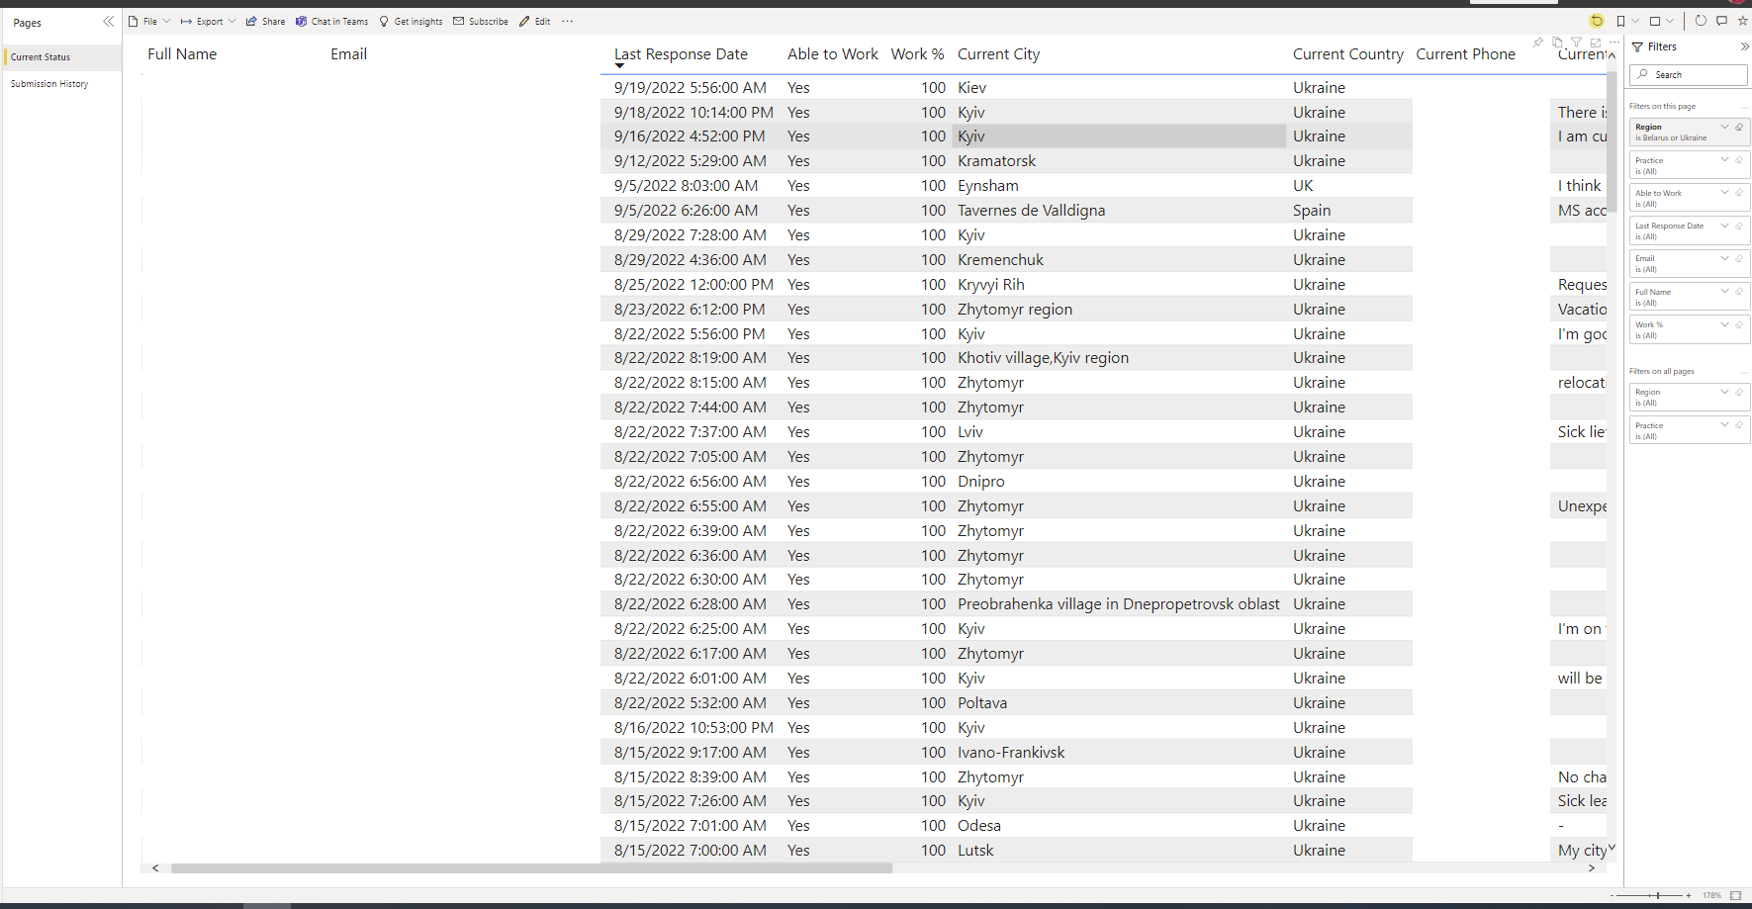
V2 Reporting

Slide 10
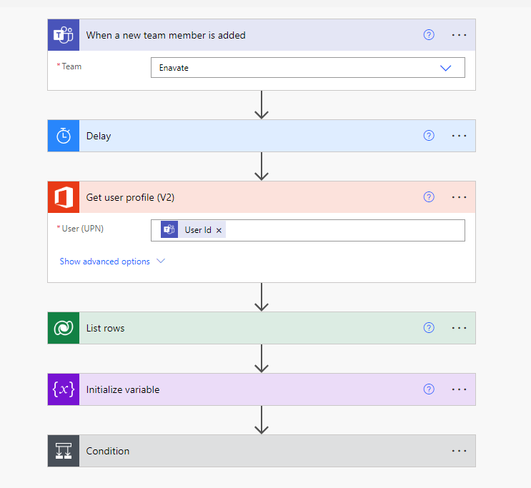
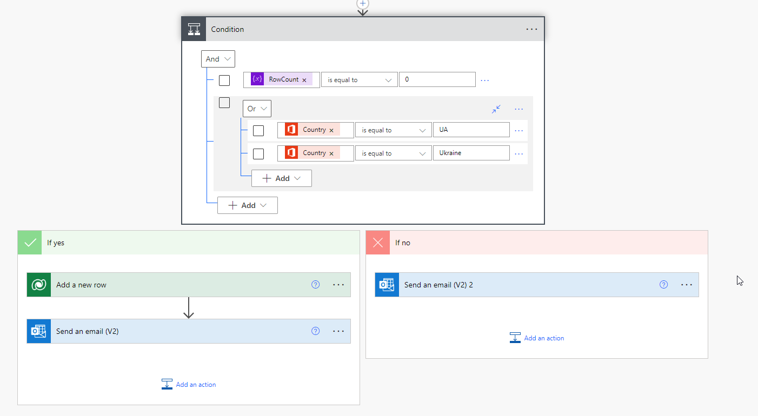
View of App (Learnings and Changes)
Notes:
Jen tells the story on the iterations (Story on the Power Automate to pull in new Team Members when they on

Slide 11
The Power to Help Run Your Business
Reduce manual efforts
Year-End reviews
Customer call tracking
Much more
Benefits
Efficient
Inexpensive
Minimal Training
(App in Day)

Slide 12
Next Steps
Rethink how you are doing things now- Are you being efficient as possible?
You can learn more here Power Apps Demos | Microsoft Power Apps

Slide 13
Check Out Our Next Sessions!
    Thursday | October 13 | 9 a.m. Osceola A-Convention Center , Level 2
    - GP to BC: Sneak Peak See What Dynamics GP Processes Look Like in Business Central
    Thursday | October 13 | 11:15 a.m. Naples 3 -Convention Center , Level 2
    - GP to BC: Make Your Move Easy with Microsoft’s Enhanced Migration Tool

Slide 14
Q & A

Slide 15
If you have any other questions, please see us after this session or at the Enavate Booth (#1214).
Kevin Armstrong
Global Enterprise Strategy Leader
ENAVATE
Jennifer Ranz
Product POD Leader
ENAVATE

Slide 16
Support Our Dynamics Teams in the Ukraine!

